Slide 1


Typescript Fundamentals

Slide 2



Agenda
Typescript Overview
Typescript Installation & Setup
Typescript Basics
Typescript with React
Typescript React Props
Typescript React State
Unit Testing

Slide 3

Typescript Overview

Slide 4
Introduction
TypeScript is a strongly typed programming language that builds on JavaScript, giving you better tooling at any scale.
Typescript is developed by Microsoft.
Used for developing applications at scale.
Catch errors early in development stage.
TypeScript code converts to JavaScript, which runs anywhere JavaScript runs.

Slide 5
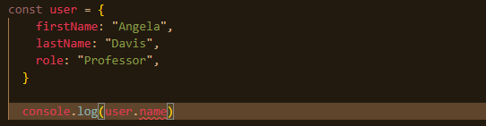
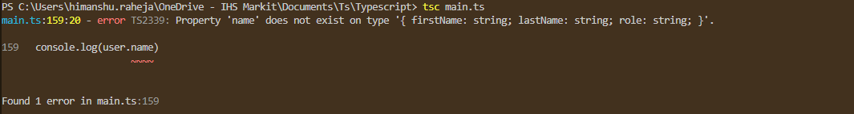
Example:
In JavaScript you won’t get any error for this. Output will be undefined.
In typescript you will get an error:

Slide 6
Installation & Setup

Slide 7
Using Node:
Installation with node is super simple, open your command prompt and run:
npm install -g typescript
This command will install latest version of typescript globally.
To install specific version, use:
npm install -g typescript@next

Slide 8
First Example
Create new file with the extension .ts for example, firstexample.ts write this simple piece of code inside the file. let team = 'Enif’ console.log(team); export {}
Save the file and run the command on cmd: tsc firstexample.ts This will compile the typescript code to javascript code and new js file with name firstexample.js will be created.
Now just run node firstexample.js on cmd,

Slide 9
Typescript Basics

Slide 10
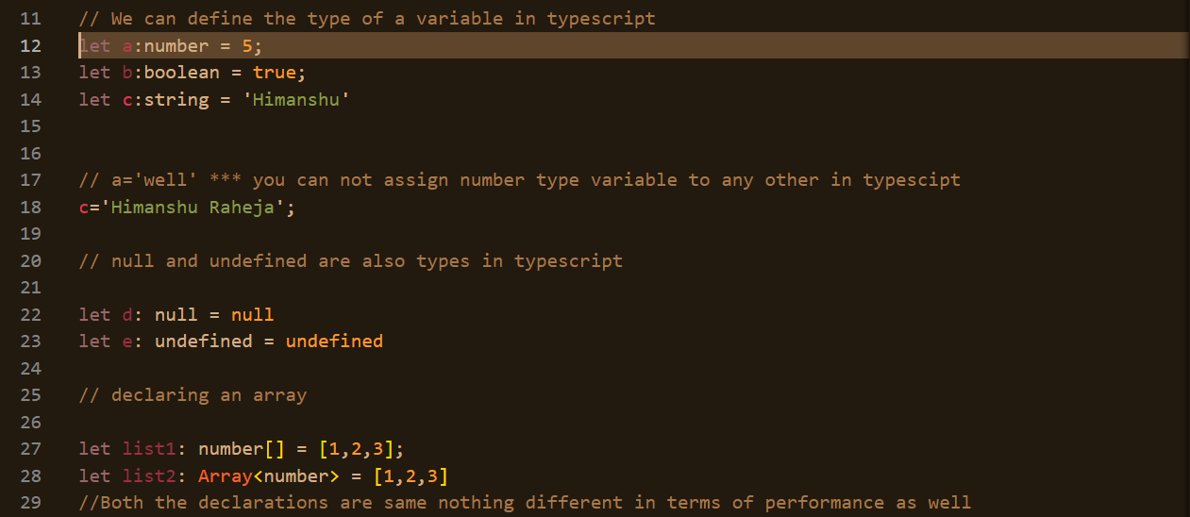
Basics – Data Types

Slide 11
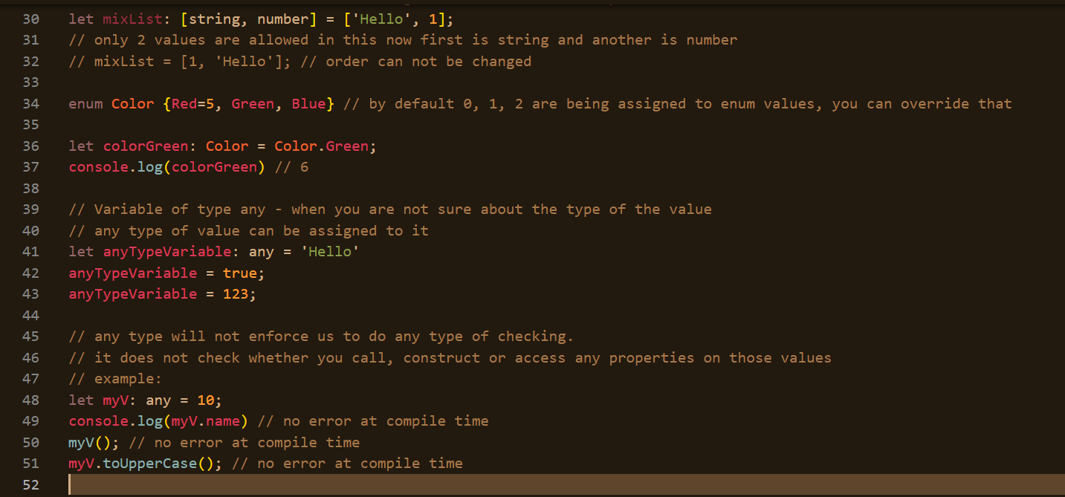
Basics – Data Types

Slide 12
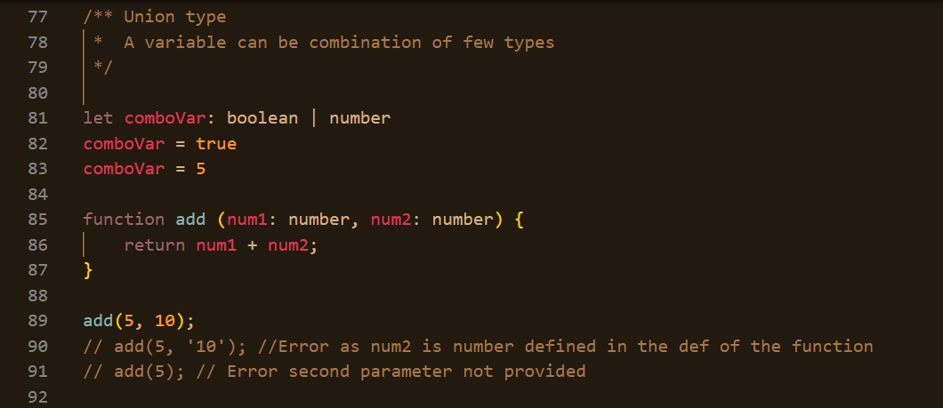
Basics – functions

Slide 13
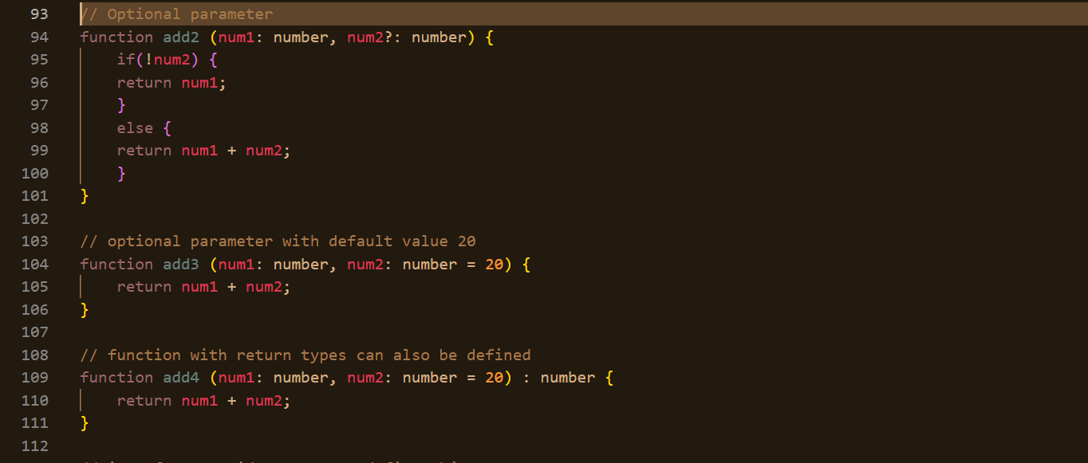
Basics – functions

Slide 14
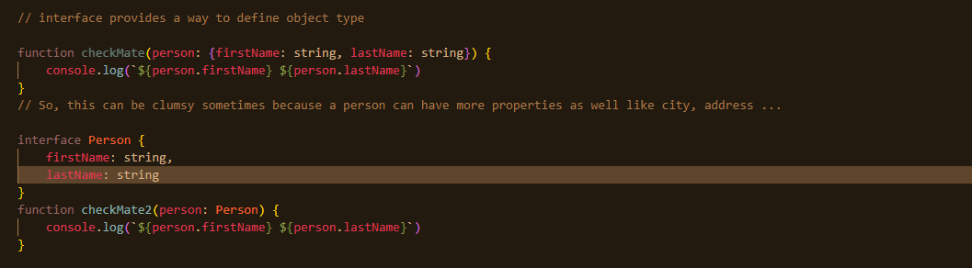
Basics – functions & Interface

Slide 15
Typescript & React

Slide 16
Why Typescript + React
With static type checking, you get to learn about potential bugs as you are writing the code, then heading to the browser and figuring it out at runtime.
Provides a way to describe the shape of the object hence better in autocomplete.
Makes maintenance and refactoring of larger code base much easier.

Slide 17
Setup React + Typescript Project
We will be using the potential of create-react-app command & setting up new react project with typescript configured, npx create-react-app react-typescript-examples –template typescript
This will create a new react app with index.tsx as entry file & App.tsx for the component file.
All the files going forward will be with extension of .tsx: typescript + xml.

Slide 18
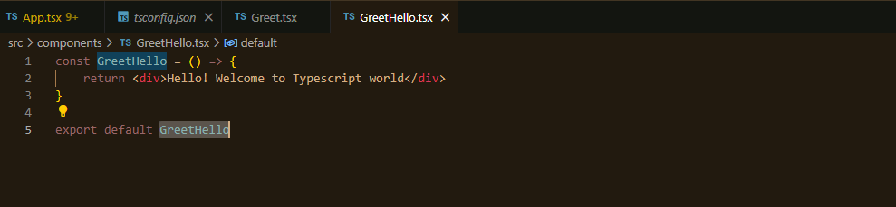
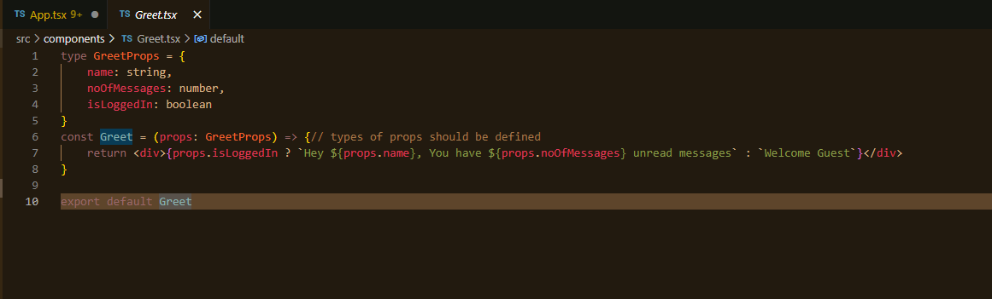
React Typescript Fundamentals

Slide 19
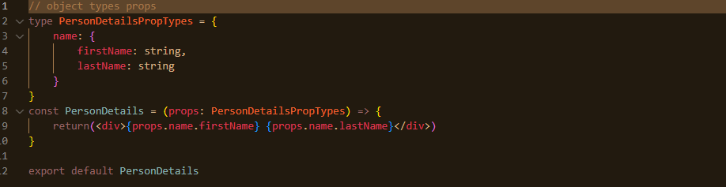
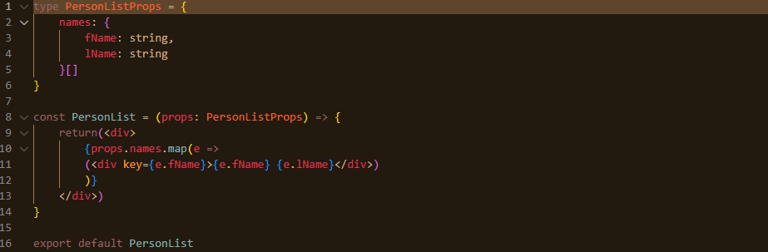
Object & Array as Props

Slide 20
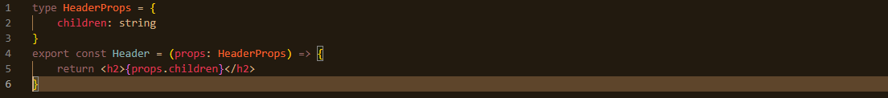
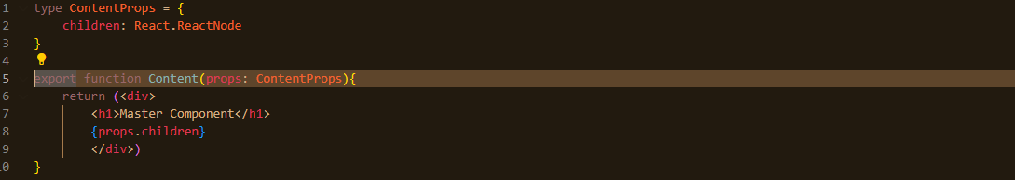
Children as Prop

Slide 21
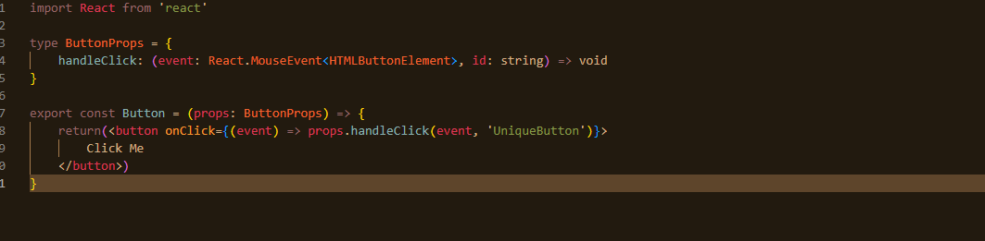
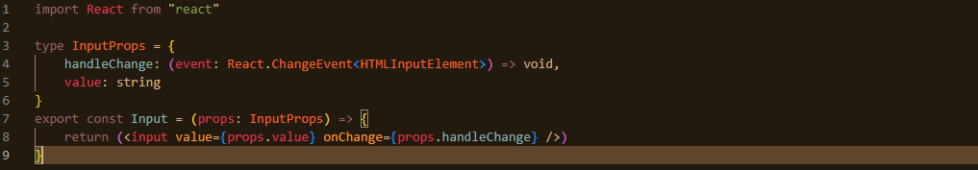
Event as Prop

Slide 22
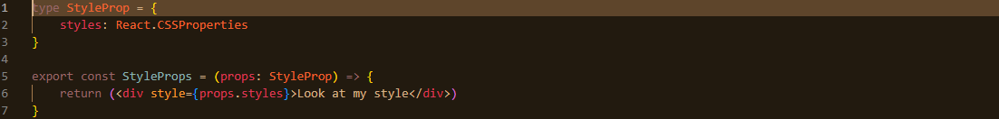
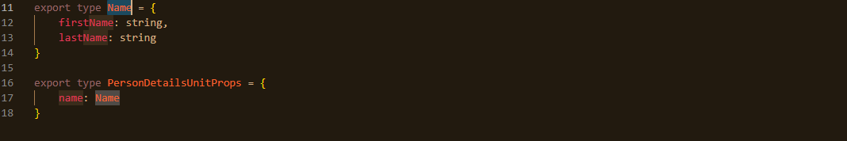
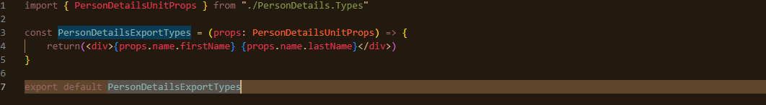
Style as Props & Reusable Types

Slide 23
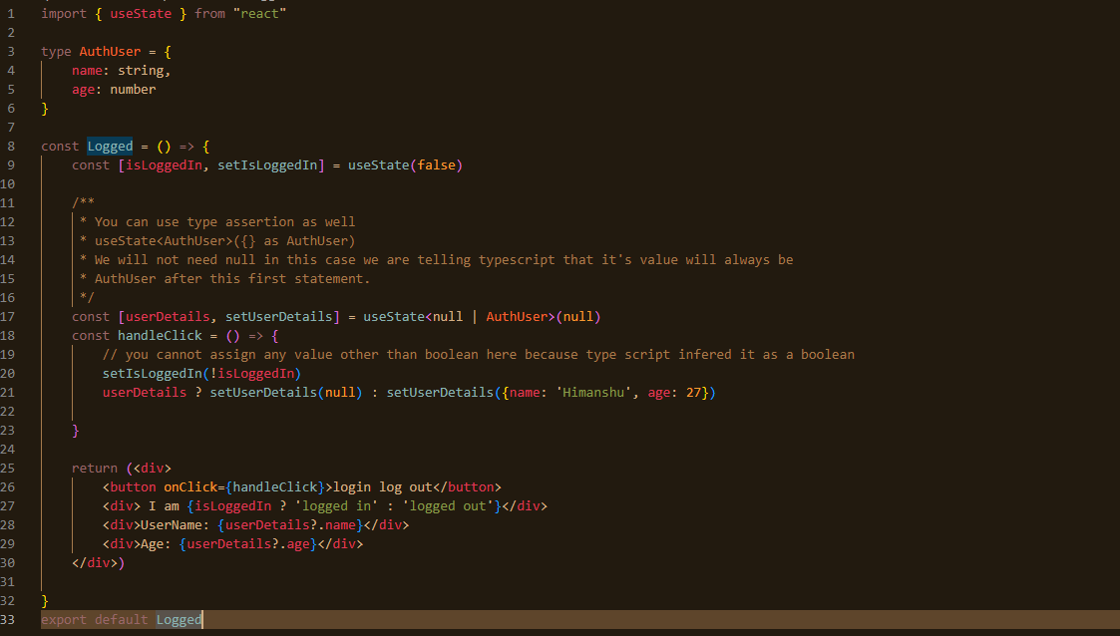
State Example

Slide 24
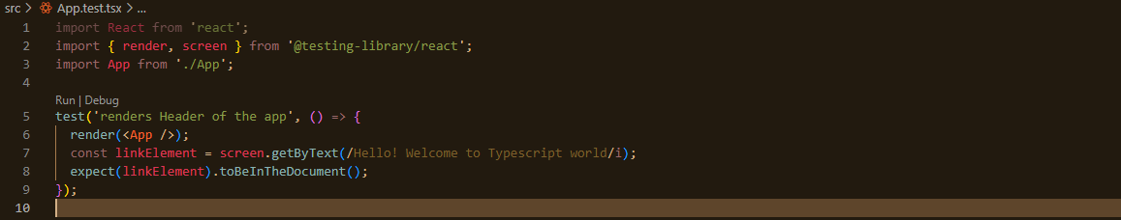
Writing Test Cases

Slide 25


Thank You

